Slide 1







Analysing
Trends in
Youtube
Key Trends and Patterns in YouTube Channel Data
Done by Sharon Sujan

Slide 2
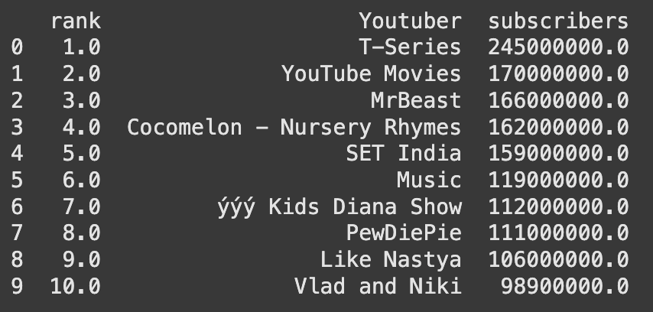
Top 10 YouTube channels with most subscribers

Slide 3

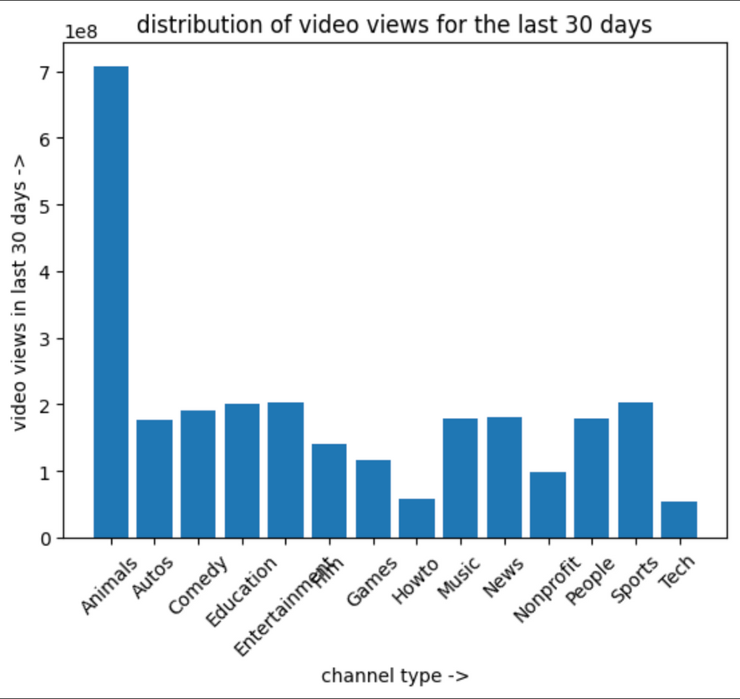
Category wise analysis
Average No. of videos uploaded by YouTube channels in each category
Category animals has the highest average video views
Category Shows has the highest average number of subscribers.

Slide 4
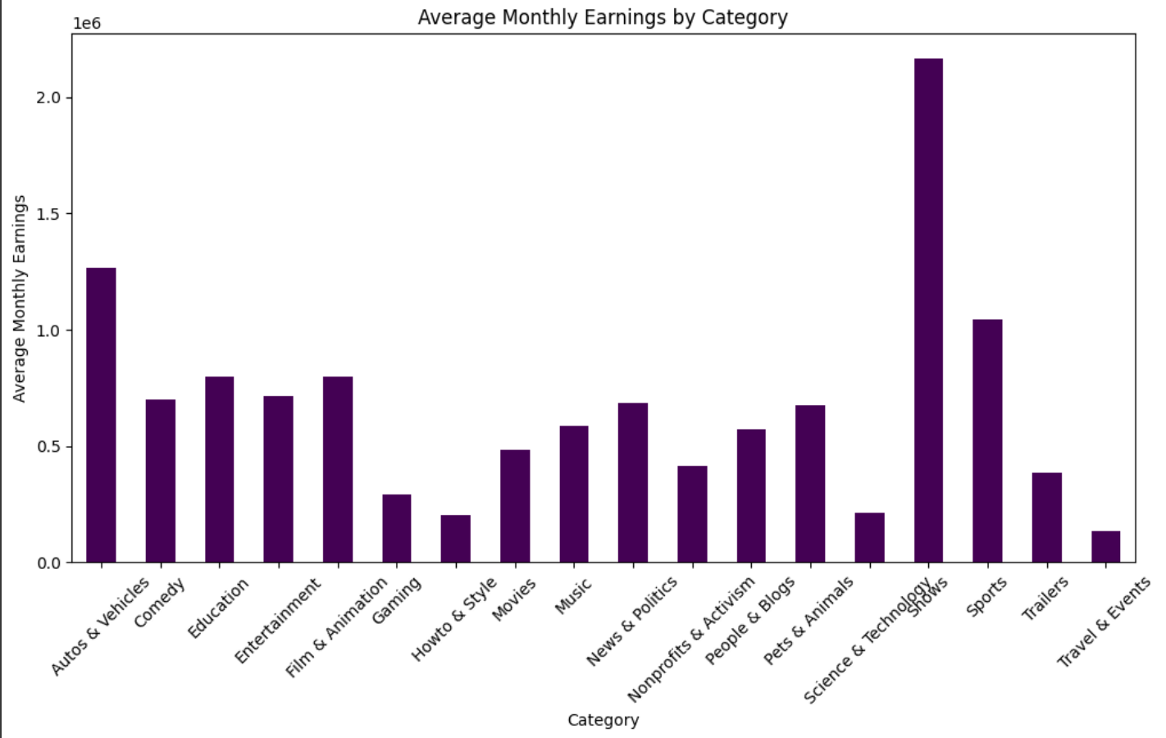
Category wise analysis
The category 'shows' has the highest average monthly earnings, followed by autos & vehicles and sports. The lowest earning categories were travel & events followed by how to & style and pets & animals.

Slide 5
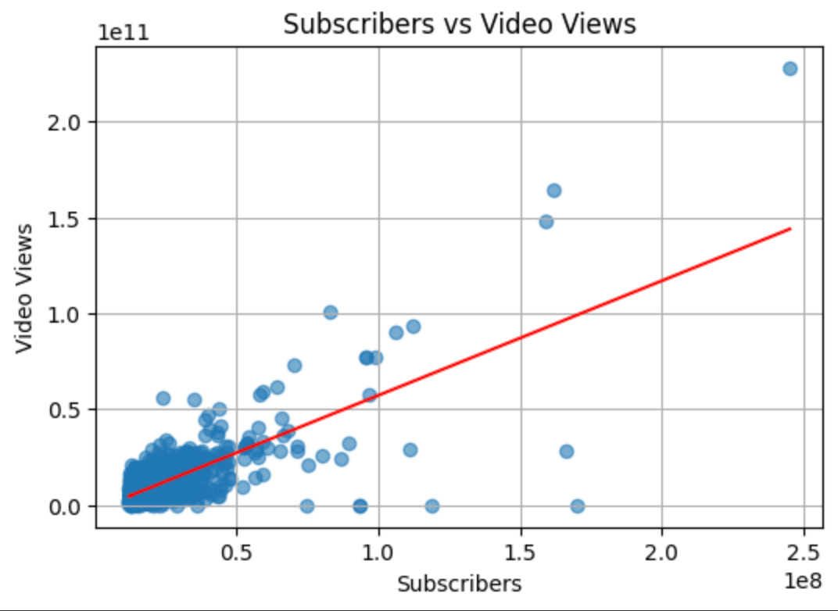
Subscribers VS Video views
The correlation coefficient between Subscribers and Video Views is 0.74 which means that there a moderate to strong positive correlation.
As subscribers increase, video views will also increase.

Slide 6
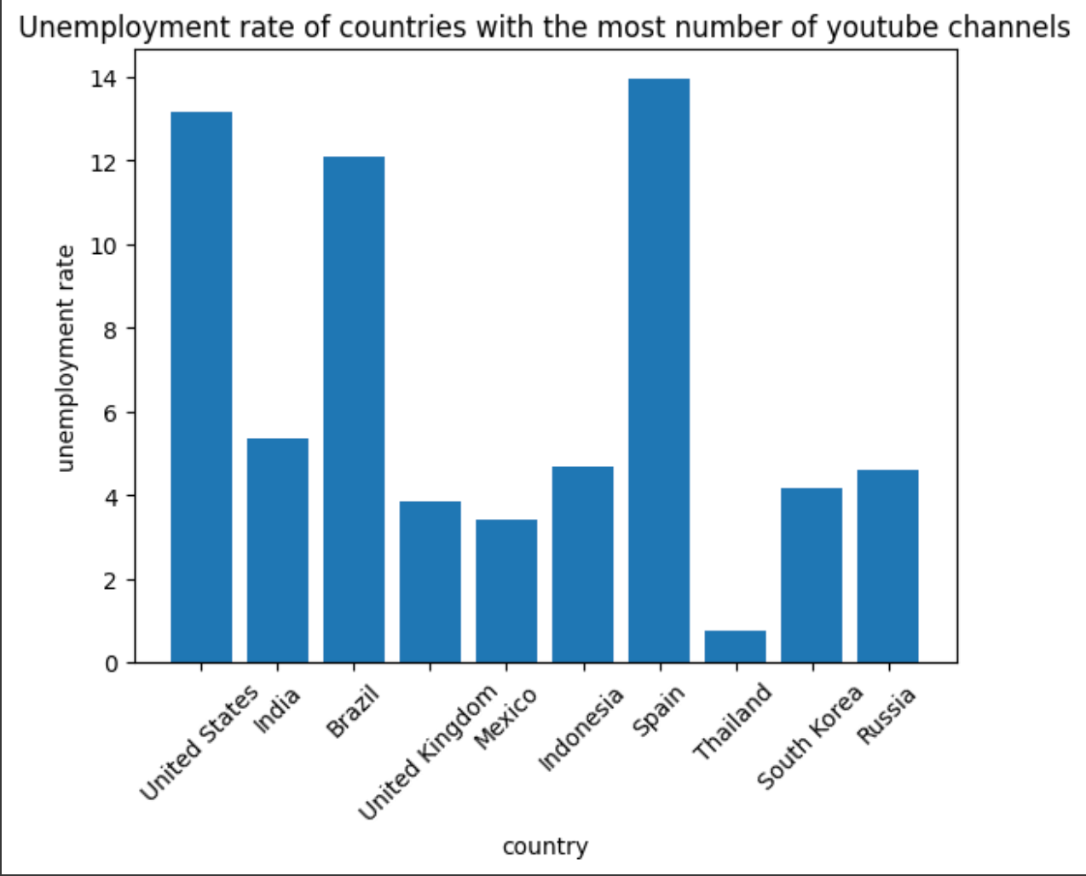
Unemployment rate
The unemployement rate in the top 10 countries with the most number of youtube channels is quite high.

Slide 7
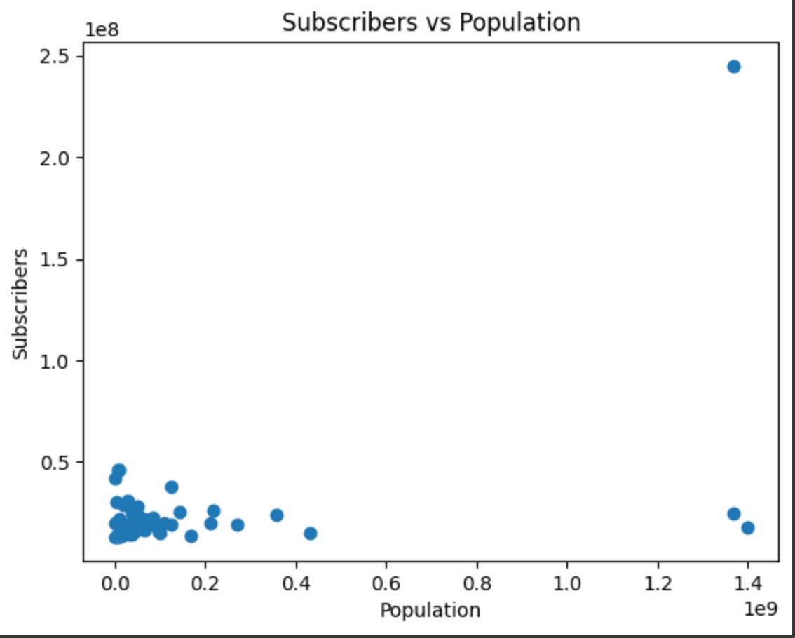
Subscribers vs Population
The correlation coefficient is 0.51 which means that there is a slight positive relation hence the more the population of the country, the more subscribers for the channels based in that area.

Slide 8
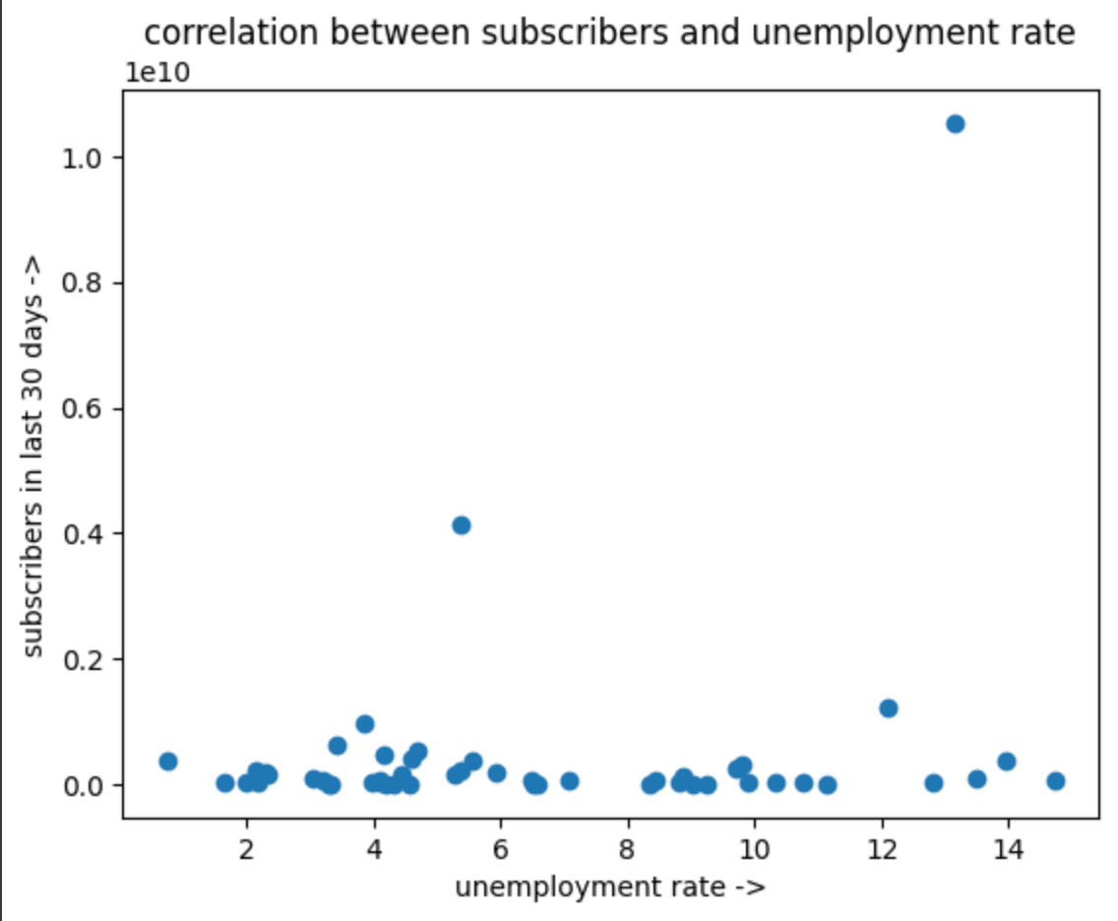
Subscribers vs Unemployment rate
The correlation coefficient is 0.225 which means that there is a very slight positive relation so when unemployment rate increases, the number of subscribers gained may also increase, but the relationship is weak.

Slide 9
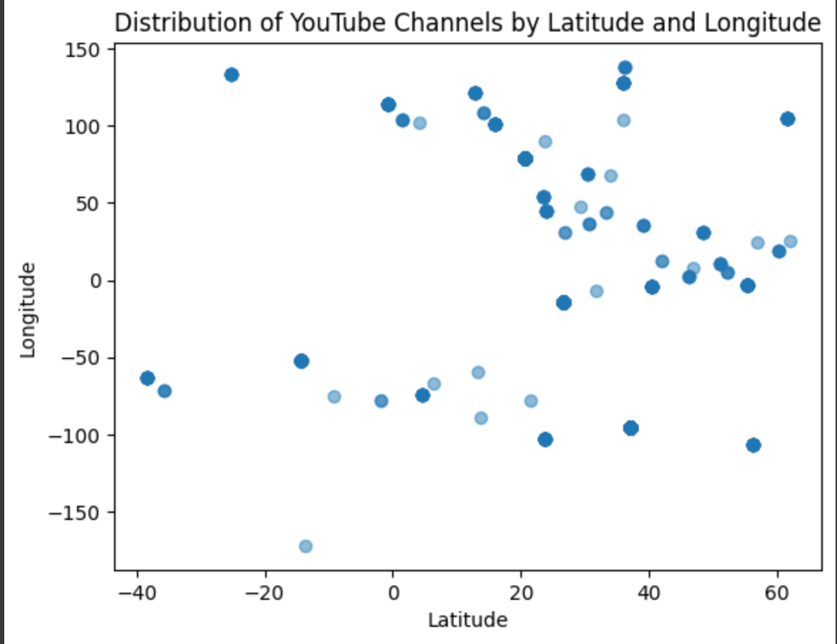
Distribution of youtube channels
By analysing the scatter plot of latitude and longitude distribution we can say that the channels are concentrated around North America,Europe and Asia

Slide 10



THANK
YOU

